Slide 1
Programming ‘GoLanguage’ {
[
]
< By Annur Akbar Bahagia>
}
GO Language

Slide 2
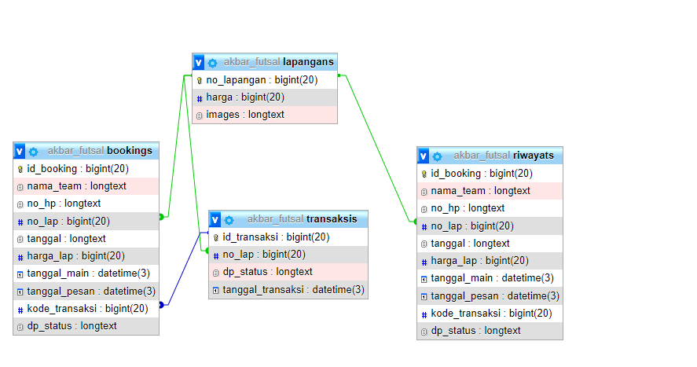
‘Relasi Table’;
GO Language

Slide 3
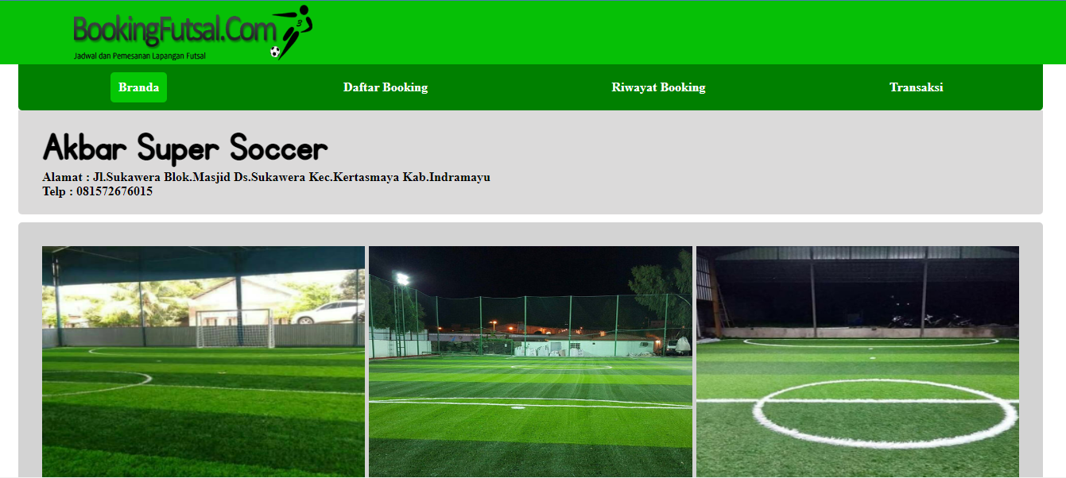
‘Menu Lapangan’;
GO Language

Slide 4
Function {
[ 1. Get 2. Post 3. Update 5. Delete ]
‘Fungsi’;
}
GO Language

Slide 5
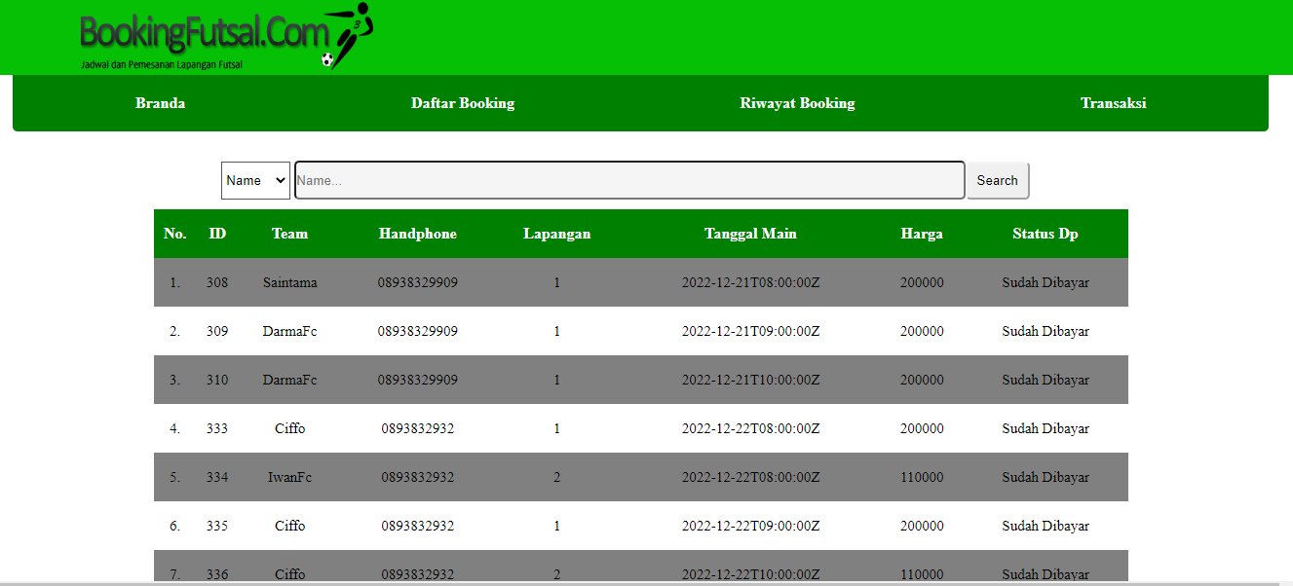
‘Menu List Booking’
GO Language

Slide 6
Function {
[ 1. Get(all, name,tanggal) 2. Post 3. Update 5. Delete ]
‘Fungsi’;
}
GO Language

Slide 7
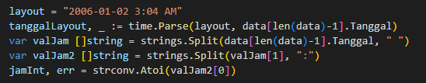

‘Source Code’
GO Language

Slide 8
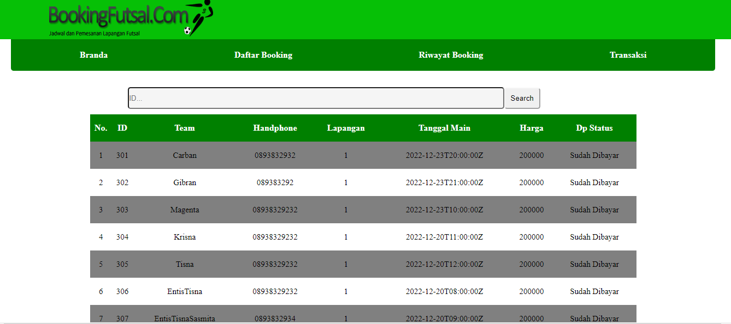
‘Menu Riwayat Booking’
GO Language

Slide 9
Function {
[ 1. Get(all,Id) ]
‘Fungsi’;
}
GO Language

Slide 10
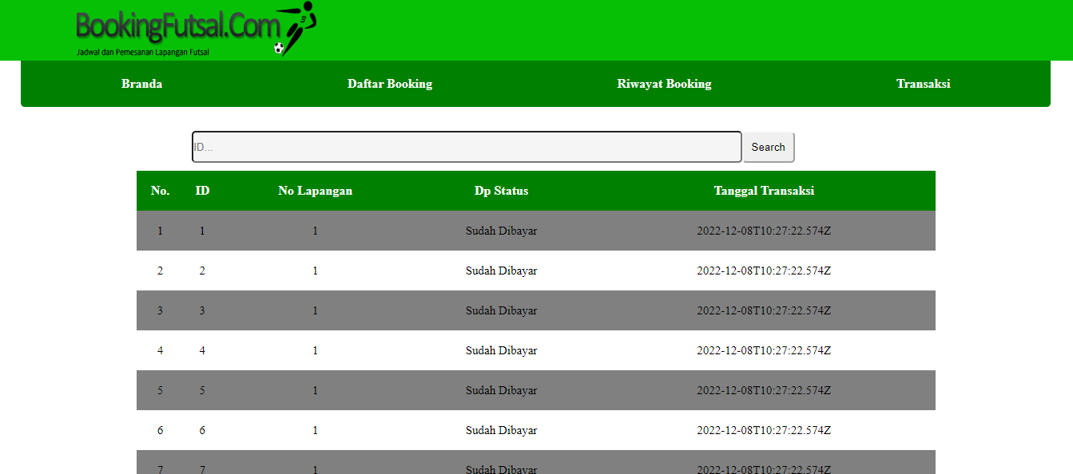
‘Menu Transaksi’
GO Language

Slide 11
Function {
[ 1. Get(all,Id) 2. Post 3. Update 4. Delete ]
‘Fungsi’;
}
GO Language

Slide 12

‘TAMAT’{ Terimakasih
}

